Slide 1
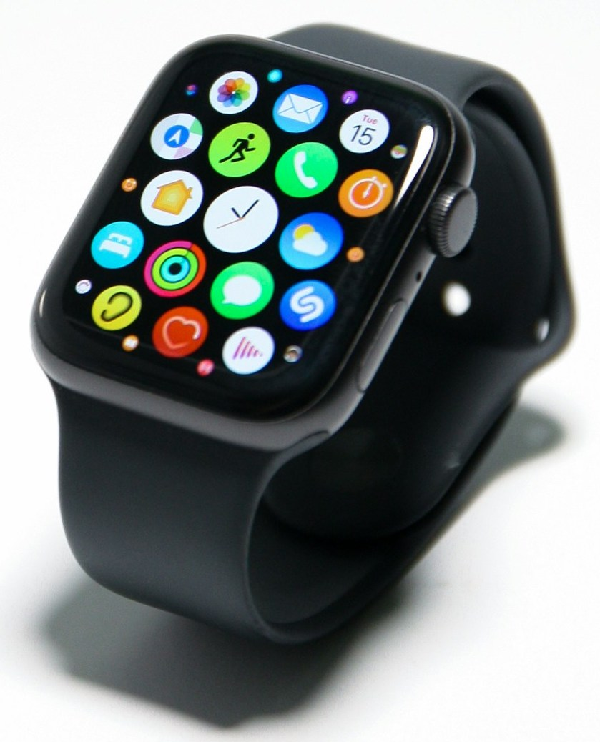
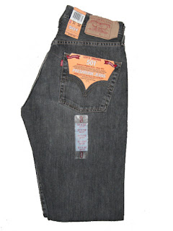

RDF motivation
Wearables
Watches
Loose Jeans
Pants
Biographies
Novels
Smart Watches
Clothing
Books
38mm
40mm
Wool
Canvas
Penguin
Wiley
screen
sizes
material
publishers
42 mm
Cotton
Scholastic
Many other properties

Slide 2
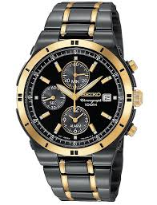
RDF motivation
Wearables
Watches
Wearables
Watches
Smart Watches
Electronics
Smart Watches
… | … | …
Watches
… | … | …
Wearables
… | … | …
Electronics
… | … | …

Slide 3
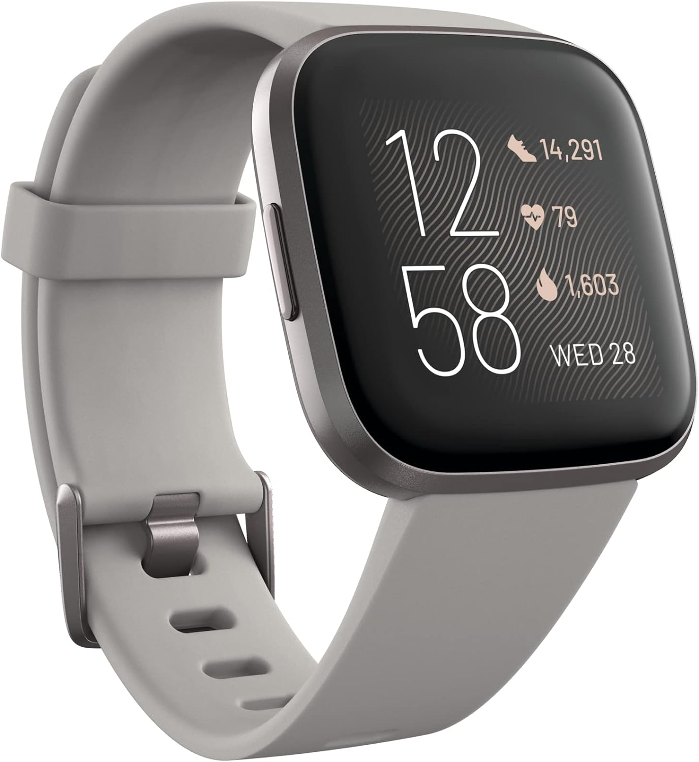
RDF motivation
4 screen-size
10 series
3rd party apps
multiple OS
…
1 screen-size
1 series
waterproof
…
Too much irregularity and complexity

Slide 4
Object-oriented/Graph-based data model
Objects/nodes
Type hierarchies
Irregularities in data & connections of objects
Product
Clothing
Wearables
Pants
Watches
Books
Loose Jeans
Slim Jeans
Smart Watches
Classic Watches
Levi’s 511
Levi’s 512
Apple Watch
Watch B
Book C
size
price
series
bat. life
author
editor
size
series
desc.
32
34
$20
8
10
14hr
“1968
Classic Watch”
Alice Munroe
John Smith

Slide 5
RDF component 1: Resources & IRIs
Resources are objects to represent:
Entities
Types
Properties
gc:Levis511
gc:Levis512
gc:JeansY
gc:AppleWatch
gc:LooseJeans
gc:Jeans
gc:Pants
gc:Watches
gc:price
LooseJean
name:Levi’s 511
price: $20
International Resource Identifiers (IRIs): URL-like object identifiers
namespace:localID
gc: → “http://global-corps.io/rdf-ex#”
gc:Levis511 → “http://global-corps.io/rdf-ex#Levis511”

Slide 6
RDF component 2: Literals
Data values:
20
“Foo bar”
01/01/2024

Slide 7
RDF component 3: Triples
(subject, verb/predicate, object) sentences
(Levi's 511) (is a type of) (LooseJeans)
subject
verb
object
<gc:Levis511, rdf:type, gc:LooseJeans>
(Levi's 511) (has a price of) (32)
<gc:Levis511, gc:price, 20>

Slide 8
RDF as a graph-based model
gc:Product
rdfs:subClassOf
rdfs:subClassOf
gc:Wearables
gc:Electronics
rdfs:subClassOf
rdfs:subClassOf
rdfs:subClassOf
gc:Jeans
rdfs:subClassOf
Smart Watches
rdfs:subClassOf
gc:LooseJeans
gc:SlimJeans
rdf:type
rdf:type
rdf:type
rdf:type
gc:Levis511
gc:JeansX
gc:Levis512
gc:AppleWatch
gc:size
gc:size
gc:desc
gc:contains
gc:date
gc:size
gc:price
gc:series
“Levi’s classic slim fit jeans”
32
34
20
36
gc:denim
8
01/01/2024

Slide 9
Irregular properties across Resources
gc:Product
rdfs:subClassOf
rdfs:subClassOf
gc:Wearables
gc:Electronics
rdfs:subClassOf
rdfs:subClassOf
rdfs:subClassOf
gc:Jeans
rdfs:subClassOf
Smart Watches
rdfs:subClassOf
gc:LooseJeans
gc:SlimJeans
rdf:type
rdf:type
rdf:type
rdf:type
gc:Levis511
gc:JeansX
gc:Levis512
gc:AppleWatch
gc:size
gc:size
gc:desc
gc:contains
gc:date
gc:size
gc:price
gc:series
“Levi’s classic slim fit jeans”
32
34
20
36
gc:denim
8
01/01/2024

Slide 10
Irregular properties across Resources
gc:Product
rdfs:subClassOf
rdfs:subClassOf
gc:Wearables
gc:Electronics
rdfs:subClassOf
rdfs:subClassOf
rdfs:subClassOf
gc:Jeans
rdfs:subClassOf
Smart Watches
rdfs:subClassOf
gc:LooseJeans
gc:SlimJeans
rdf:type
rdf:type
rdf:type
rdf:type
gc:Levis511
gc:JeansX
gc:Levis512
gc:AppleWatch
gc:size
gc:size
gc:desc
gc:contains
gc:date
gc:size
gc:price
gc:series
“Levi’s classic slim fit jeans”
32
34
20
36
gc:denim
8
01/01/2024

Slide 11
Irregular properties across Resources
gc:Product
rdfs:subClassOf
rdfs:subClassOf
gc:Wearables
gc:Electronics
rdfs:subClassOf
rdfs:subClassOf
rdfs:subClassOf
gc:Jeans
rdfs:subClassOf
Smart Watches
rdfs:subClassOf
gc:LooseJeans
gc:SlimJeans
rdf:type
rdf:type
rdf:type
rdf:type
gc:Levis511
gc:JeansX
gc:Levis512
gc:AppleWatch
gc:size
gc:size
gc:desc
gc:contains
gc:date
gc:size
gc:price
gc:series
“Levi’s classic slim fit jeans”
32
34
20
36
gc:denim
8
01/01/2024

Slide 12
Type hierarchies
gc:Wearables
rdfs:subClassOf
gc:Jeans
rdfs:subClassOf
<gc:Levis511, rdf:type, gc:LooseJeans>
gc:LooseJeans
rdf: → “http://www.w3.org/1999/02/22-rdf-syntax-ns#”
rdfs:subClassOf
rdfs: → “http://www.w3.org/2000/01/rdf-schema#”
rdf:type
gc:Levis511

Slide 13
Multiple types/super-classes
gc:Product
rdfs:subClassOf
rdfs:subClassOf
gc:Wearables
gc:Electronics
rdfs:subClassOf
rdfs:subClassOf
rdfs:subClassOf
gc:Jeans
rdfs:subClassOf
Smart Watches
rdfs:subClassOf
gc:LooseJeans
gc:SlimJeans
rdf:type
rdf:type
rdf:type
rdf:type
gc:Levis511
gc:JeansX
gc:Levis512
gc:AppleWatch
gc:size
gc:size
gc:desc
gc:contains
gc:date
gc:size
gc:price
gc:series
“Levi’s classic slim fit jeans”
32
34
20
36
gc:denim
8
01/01/2024

Slide 14
Multiple types/super-classes
gc:Product
rdfs:subClassOf
rdfs:subClassOf
gc:Wearables
gc:Electronics
rdfs:subClassOf
rdfs:subClassOf
rdfs:subClassOf
gc:Jeans
rdfs:subClassOf
Smart Watches
rdfs:subClassOf
gc:LooseJeans
gc:SlimJeans
rdf:type
rdf:type
rdf:type
rdf:type
gc:Levis511
gc:JeansX
gc:Levis512
gc:AppleWatch
gc:size
gc:size
gc:desc
gc:contains
gc:date
gc:size
gc:price
gc:series
“Levi’s classic slim fit jeans”
32
34
20
36
gc:denim
8
01/01/2024

Slide 15
Uniform data + schema modeling
LooseJeans
name | size | price

Slide 16
Uniform data + schema modeling
CREATE TABLE LooseJeans (
name VARCHAR,
size INT,
price INT)
LooseJeans
name | size | price
Levi’s 511 | 32 | 20
… | … | …
INSERT INTO LooseJeans (...)
VALUES (“Levi’s 511, 32, 20)

Slide 17
Uniform data + schema modeling
LooseJeans
name | size | price
Levi’s 511 | 32 | 20
… | … | …
gc:Jeans
Regulations
table name | reg. name
LooseJeans | Textile Labeling Act
rdfs:subClassOf
gc:LooseJeans
rdf:type
gc:subjectTo
gc:Levis511
gc:TextileLabelingAct
gc:price
20

Slide 18
Querying RDF databases
Which sizes of Levi’s 511 jeans are sold?
SELECT ?x
WHERE {
gc:Levis-511 gc:size ?x .
}
?x
32
34
...
gc:Levis511
gc:size
gc:size
...
32
34

Slide 19
Querying RDF databases
Which products are subject to Textile Labeling Act?
SELECT ?p
WHERE {
?p rdf:type ?c .
?c gc:subjectTo gc:TextileLabelingAct .
}
...
?p
gc:Levis511
gc:JeansX
gc:subjectTo
gc:LooseJeans
gc:TextileLabelingAct
rdf:type
rdf:type
gc:Levis511
gc:JeansX
gc:size
gc:price
gc:size
gc:size
32
34
20
36

Slide 20
Example data+schema querying
Sizes of products that are subject to Textile Labeling Act?
SELECT ?x
WHERE {
?p rdf:type ?c .
?c gc:subjectTo gc:TextileLabelingAct .
?p gc:size ?x
}
...
?x
32
34
36
gc:subjectTo
gc:LooseJeans
gc:TextileLabelingAct
rdf:type
rdf:type
gc:Levis511
gc:JeansX
gc:size
gc:price
gc:size
gc:size
32
34
20
36

Slide 21
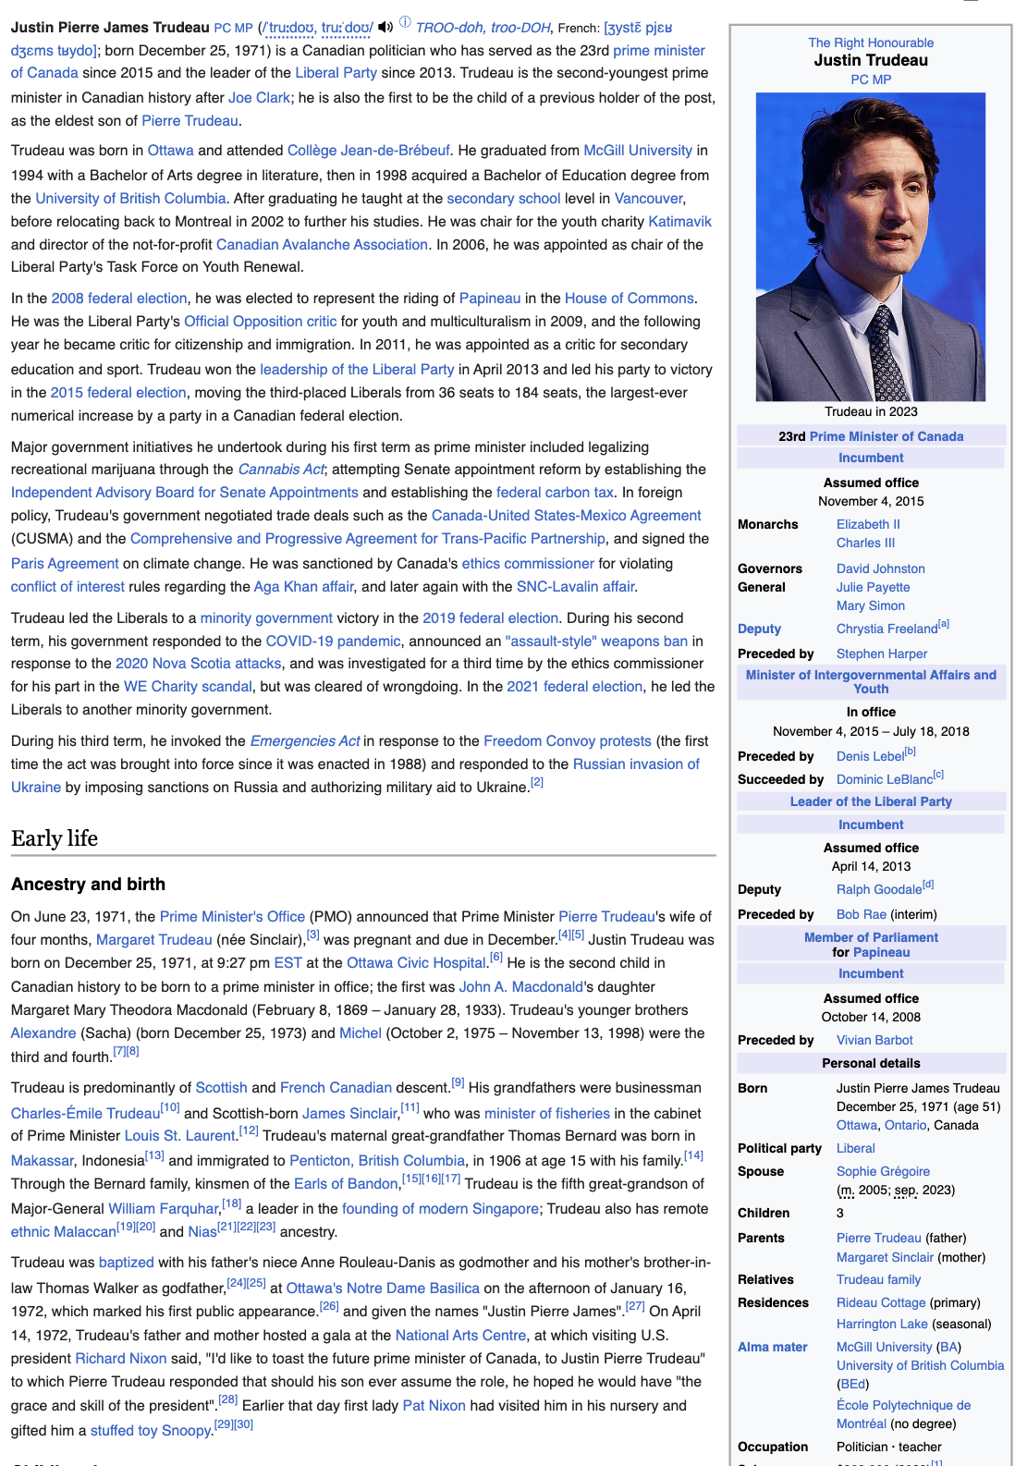
Another motivating example for RDF
What would the tables be?
Politicians?
Prime Ministers?
Canadians?
Humans?
What would the columns be?
Too complex & irregular to structure

Slide 22
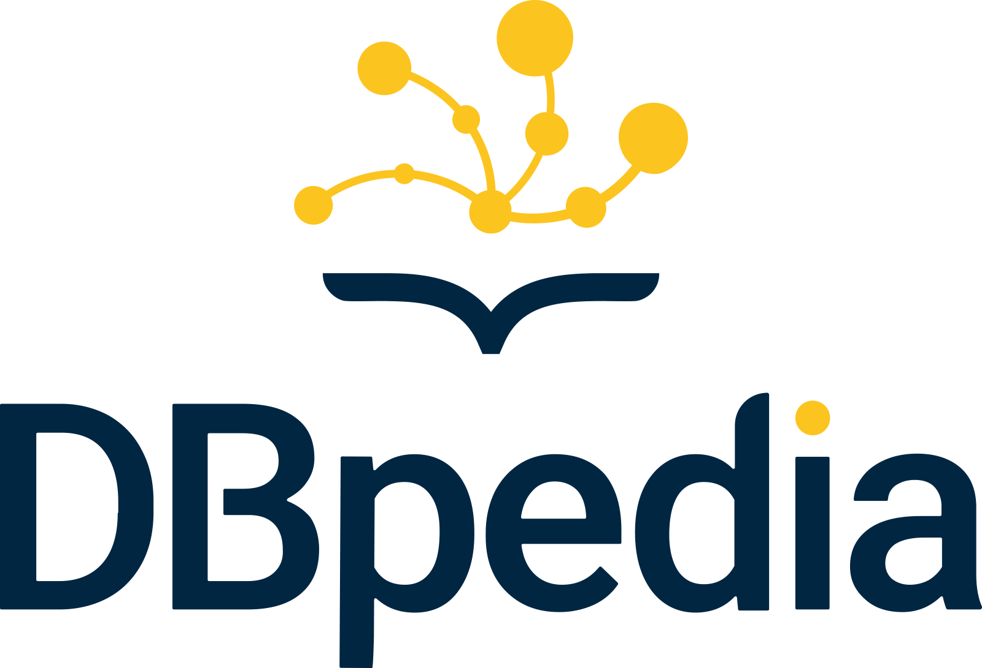


Another motivating example for RDF
Turning Wikipedia into a database of records is the goal of several projects
All use RDF
M. Trudeau
Liberal Party
dbr:mother
dbr:party
J. Trudeau
dbr:residence
dbr:residence
Rideau Cottage
Harrington Lake

Slide 23
RDF is more than a data model:
“Knowledge Representation & Reasoning System”
RDF Standards:
OWL
SPARQL
RDFS
RDF

Slide 24
RDF standards
Standardized vocabulary, i.e. IRIs. If a DBMS implements these standards:
Facilitates basic reasoning & infer new triples in a database
rdf:type → http://www.w3.org/1999/02/22-rdf-syntax-ns#type
Types of resources
rdfs:subClassOf: http://www.w3.org/2000/01/rdf-schema#subClassOf
Sub/super-class relationships

Slide 25
RDF standards
Inference Rule
(x rdf:type A) & (A rdfs:subClassOf B) => (x rdf:type B)
=> (x rdf:type B)
SELECT ?p
WHERE {
?p rdf:type gc:Jeans .
}
gc:Jeans
?p
gc:Levis511
gc:JeansX
gc:Levis512
rdf:type
rdfs:subClassOf
rdfs:subClassOf
gc:LooseJeans
gc:SlimJeans
rdf:type
rdf:type
rdf:type
gc:Levis511
gc:JeansX
gc:Levis512
…
…
…
…
…
…

Slide 26
OWL inference example
owl:sameAs → http://www.w3.org/2002/07/owl#sameAs
<md:Prod123, md:merchant, md:MerchantA>
<md:Prod123, md:merchant, md:MerchantB>
<md:MerchantA, md:locatedIn, md:Waterloo>
…
Goal: Integrate merchant db with product catalogue db
models Levi’s 511 jeans
md:Prod123
md:merchant
md:merchant
md:MerchantA
md:MerchantB

Slide 27
OWL inference example
Inference Rule
(x owl:sameAs y) & (y p o) => (x p o)
=> (x p o)
SELECT ?m
WHERE {
gc:Levis511 md:merchant ?m .
}
gc:Jeans
?m
md:merchantA
md:merchantB
rdfs:subClassOf
rdfs:subClassOf
gc:LooseJeans
gc:SlimJeans
rdf:type
gc:Levis511
md:Prod123
owl:sameAs
gc:size
gc:price
md:merchant
md:merchant
gc:size
md:merchant
32
34
20
md:MerchantA
md:MerchantB

Slide 28
Custom transitive predicates: owl:TransitiveProperty
Inference Rule
(gc:contains rdf:type owl:transitiveProperty) & (x gc:contains A) & (A gc:contains B)
=> (x gc:contains B)
SELECT ?m
WHERE {
gc:Levis511 gc:contains ?m .
}
?m
gc:denim
gc:cotton
rdf:type
gc:contains
owl:TransitiveProperty
gc:contains
gc:contains
gc:Levis511
gc:denim
gc:cotton
gc:contains

Slide 29
RDF cons
Verbosity
Long IRIs
Repeated values
Scalability & Performance
General principle:
<gc:Levis511, gc:size, 32>
<gc:Levis511, gc:size, 34>
<gc:Levis512, gc:size, 36>
product | size
gc:Levis511 | 32
gc:Levis511 | 34
gc:Levis512 | 36
Relational Model &
Structured Property Graphs
DBMS Optimizations
RDF
Data Model Flexibility

Slide 30
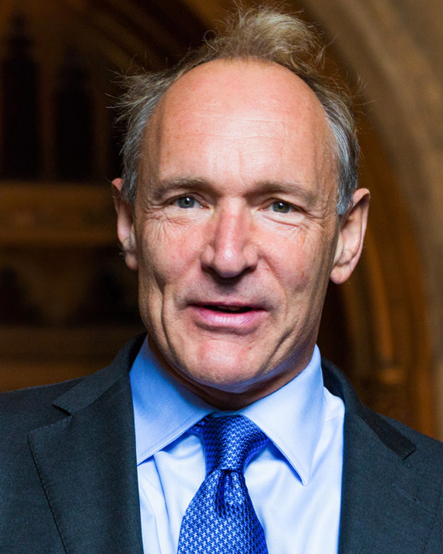
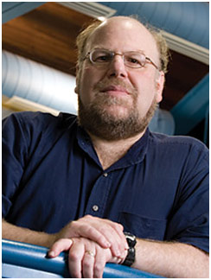
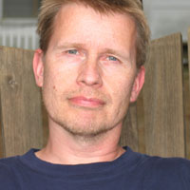





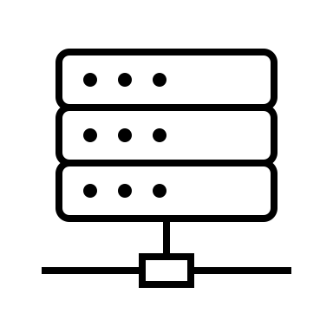
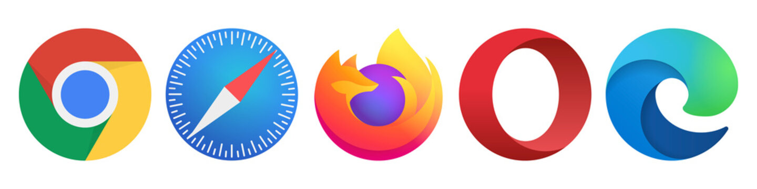
RDF History: Semantic Web
Semantic Web ideal of late 1990s & 2000s:
Original Web:
web of documents for humans
Semantic Web:
web of data for software
http://kitchenerpanthers.ca
http://kitchenerpanthers.ca/rdf
Berners-Lee
Hendler
Lassila
2001 article
http://uwaterloo.ca/hockey
http://uwaterloo.ca/hockey/rdf
http://uwaterloo.ca/rdf
http://uwaterloo.ca
http://guelph-united.ca
http://guelph-united.ca/rdf

Slide 31
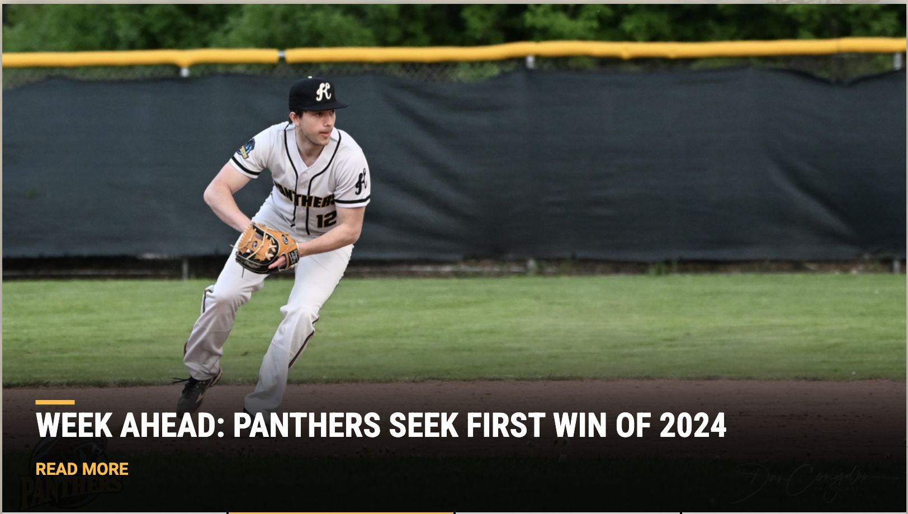
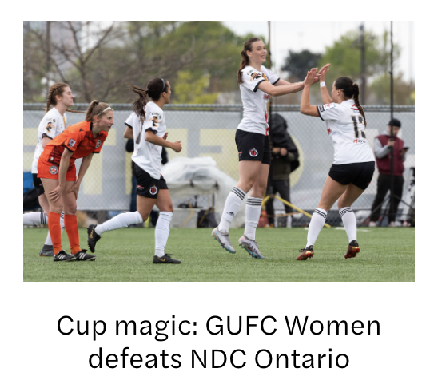
Semantic web example
Sports events within 20km of Waterloo, ON this weekend?
http://www.kitchenerpanthers.com/
http://www.guelphunitedfc.ca/
Losers of their first four games, outscored 45-17 in those games including a 27-6 defeat to Guelph last Sunday, the team can only go up from here.
…
The Panthers return home Sunday to host the Brantford Red Sox. The game will be at Jack Couch at 2pm.
…
…
The team will play their next game on Saturday in Guelph against North Mississauga SC at 4pm.
The team has several injuries form its against NDC Ontario. Marikano and Sealy will not be on the lineup.
…

Slide 32
Semantic web example
Sports events within 20km of Waterloo, ON this weekend? Center
predicate
subject
object
http://www.kitchenerpanthers.ca/rdf
http://www.kitchenerpanthers.ca/rdf/JackCouchPark
kp: https://www.kitchenerpanthers.com/rdf
dbr: https://dbpedia.org/page/
dbo: https://dbpedia.org/ontology/
<kp:Panthers rdf:type dbr:SportsTeam>
…
<kp:event1 rdf:type dbr:Sporting_Event>
<kp:event1 dbo:date 2024-05-28^xsd:date>
<kp:event1 dbo:location kp:JackCouchPark>
kp: https://www.kitchenerpanthers.com/rdf
dbr: https://dbpedia.org/page/
dbo: https://dbpedia.org/ontology/
geo: http://www.w3.org/.../wgs84_pos
<kp:JackCouchPark rdf:type dbo:Settlement>
<kp:JackCouchPark dbo:location dbr:Kitchener_ON>
…
<kp:JackCouchPark geo:lat -80.47>

Slide 33

Why is RDF suitable for semantic web?
Highly heterogeneous in nature
Very flexible data model: simple (s, p, o) sentences
Facilitates automatic reasoning
Website 1: https://www.kitchenerpanthers.com/rdf/JackCouchPark
<kp:JackCouchPark dbo:location dbr:Kitchener>
Website 2: https://dbpedia.org/page/Kitchener
<dbr:Kitchener dbo:location dbr:Ontario>
Stadiums in Ontario?
Automatically infer: <kwp:JackCouchPark dbo:location dbr:Ontario>

Slide 34
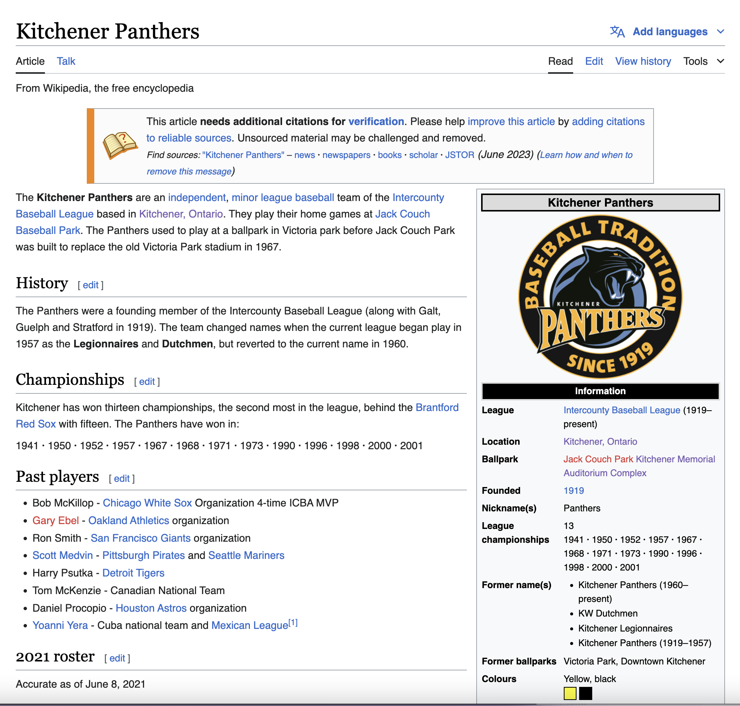
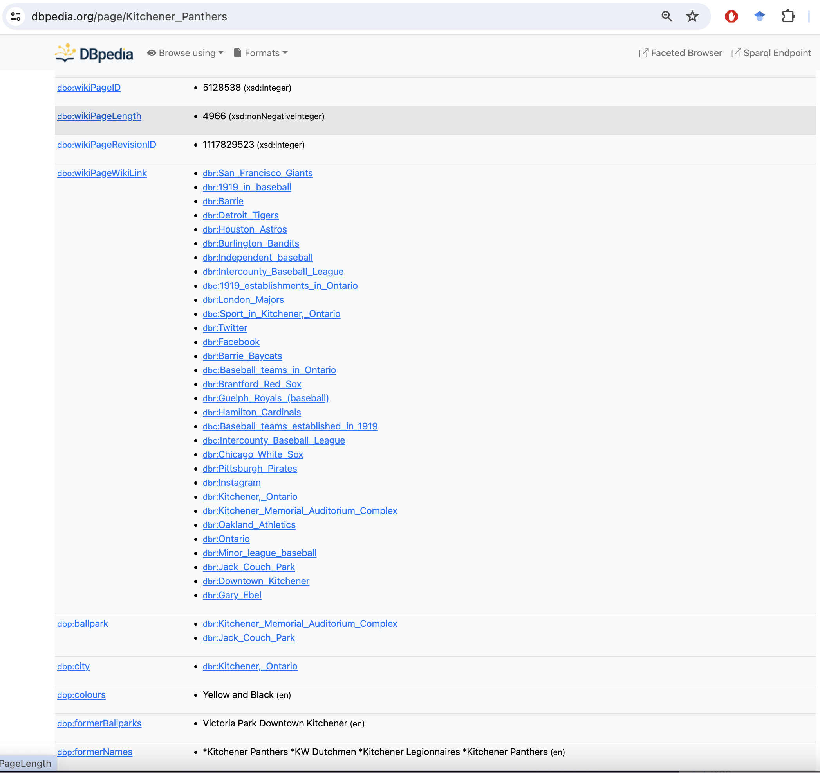
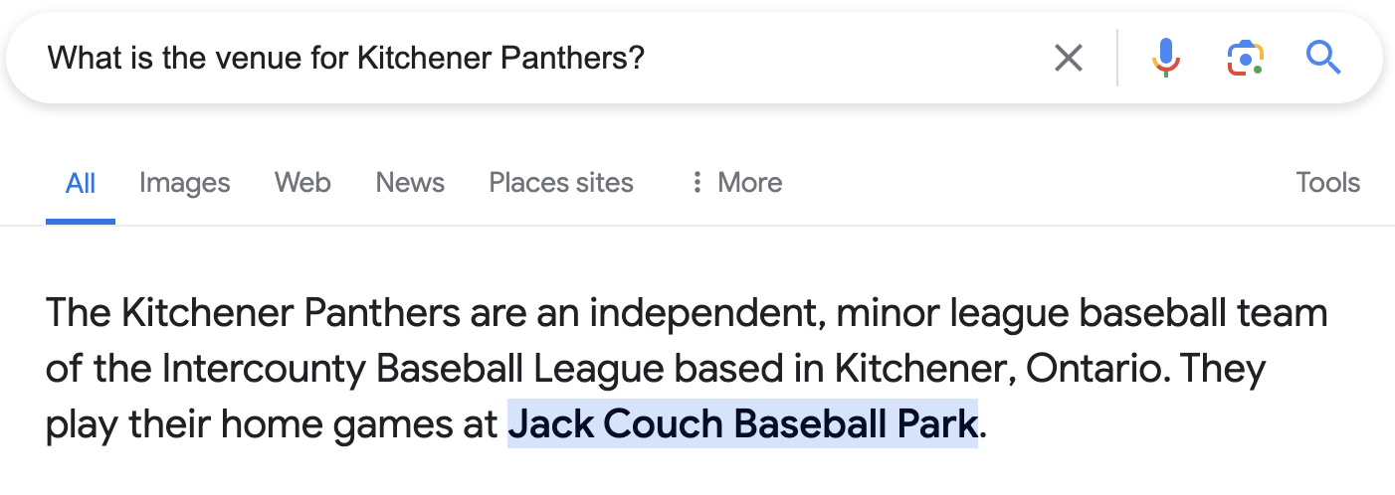
Semantic web progress: Large RDF dataset
Many public RDF datasets: DBPedia, Wikidata, Freebase
2012 Google announced use of Freebase for Q&A
Semantic web techs: RDFS,SPARQL, OWL, Schema.org
Adopted by many enterprises
DBpedia: A Nucleus for a Web of Open Data, ISWC 2007

Slide 35
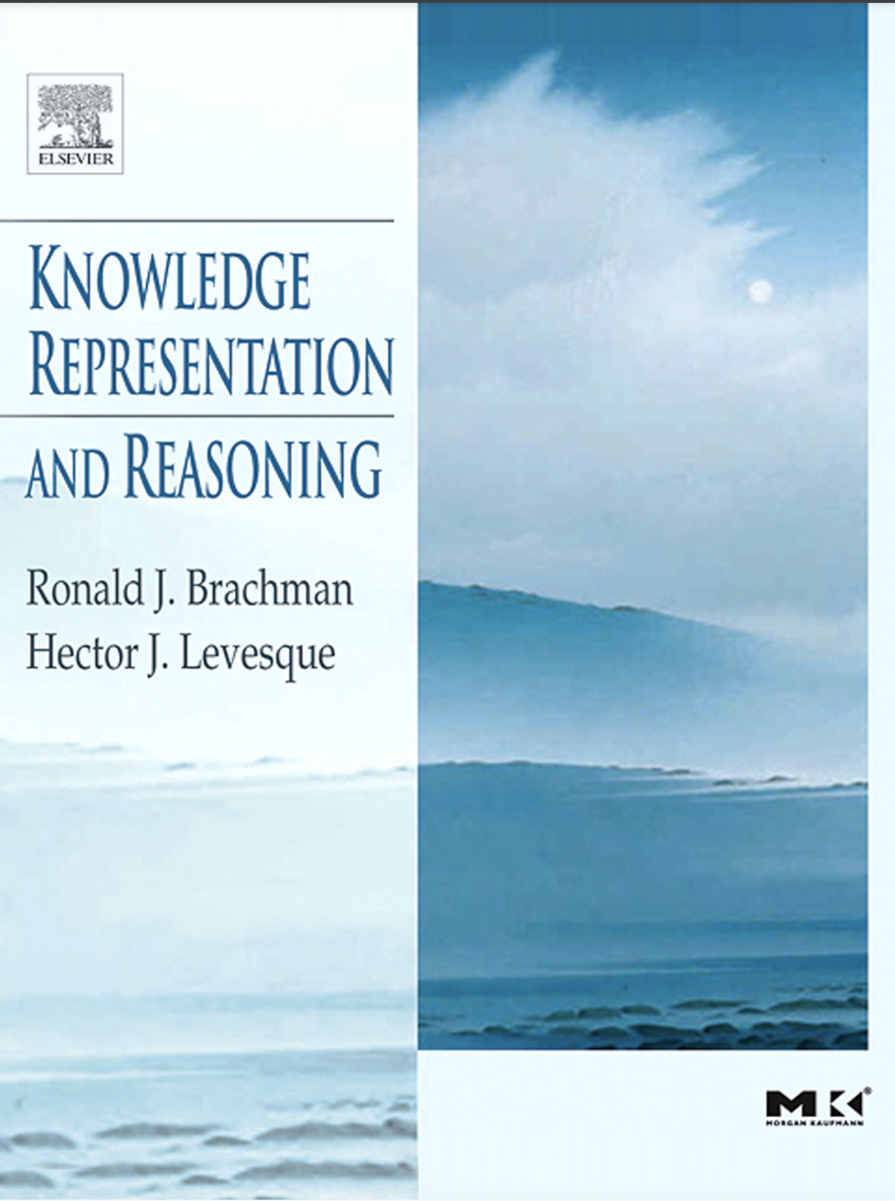
RDF & KRR in modern era of AI

Slide 36
RDF & KRR in modern era of AI
How many red boxes are above green boxes?
A
red
SELECT b1
WHERE {
?b1 abc:color abc:red .
?b1 abc:ontopOf ?b2 .
?b2 abc:color abc:green .
}
B
B
B
Possibility 1
Possibility 2
C
green
<abc:boxA, rdf:type, abc:box>
<abc:boxB, rdf:type, abc:box>
<abc:boxA, abc:onTopOf, abc:boxB>
…
<abc:boxA, abc:color, abc:red>
<abc:boxC, abc:color, abc:green>
Restrictions: owl:someValuesFrom, owl:oneOf, owl:cardinality

